Slide 1
Optical Fibers
by
Dr. Saidi Reddy Parne
Associate Professor of Physics
Dean ( R & C)
NIT Goa

Slide 2
Why Optical Fibers ?
Theoretical information capacity of Optical Communications are:
10¹⁴Hz / 1GHz(BW of each MW channel)
= 10¹⁴ /10⁹ = 10⁵ MW channels.
10¹⁴Hz/100MHz (each TV channel) = 10¹⁴ /100x10⁶
= 10x10⁶ = 10 million TV channels.
10¹⁴ Hz/1000Hz(each voice channel) = 10¹¹
= 100x1000x10⁶ = Hundred thousand
million voice channels

Slide 3
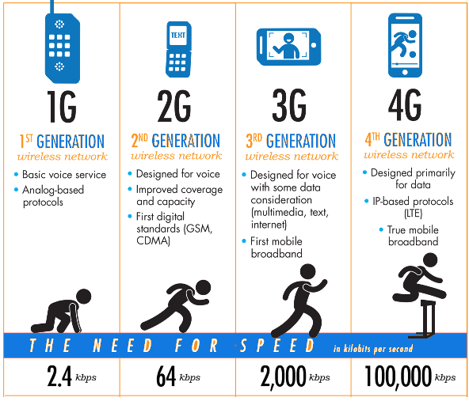
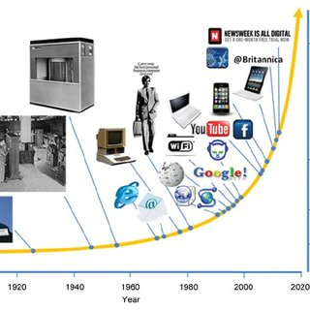
Mobile Generation

Slide 4

Fiber Vs Copper
Optical fiber transmits light pulses
Can be used for analog or digital transmission
Voice, computer data, video, etc.
Copper wires (or other metals) can carry the same types of signals with electrical pulses
/
Glass
Uses light
Transparent
Dielectric material-nonconductive
EMI immune
Low thermal expansion
Brittle, rigid material
Chemically stable
Copper
Uses electricity
Opaque
Electrically conductive material
Susceptible to EMI
High thermal expansion
Ductile material
Subject to corrosion and galvanic reactions

Slide 5
Optical fiber advantages
Capacity: much wider bandwidth (10GHz)
Crosstalk immunity
Immunity to static interface
Safety: fiber is non magnetic
Longer lasting
Security: Tapping is difficult
Economics: fewer repeaters
Cheap compared to copper

Slide 6
Small size, weight and low transmission loss
 | Fiber Cable | RG – 19/U Coaxial Cable
Weight (Kg/km) | 2 | 1110
Loss (dB/km) | 3 | 22.6
Dielectric nature and electric isolation
Signal security
Potential low cost
No permanent damage due to nuclear radiation

Slide 7
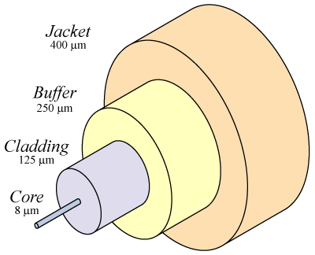
Optical fiber
Core
Carries the light signals
Silica and a dopant
Cladding
Keeps the light in the core
Pure Silica
Buffer
Protects the fiber from damage and moisture
Jacket
Holds one or more fibers in a cable

Slide 8
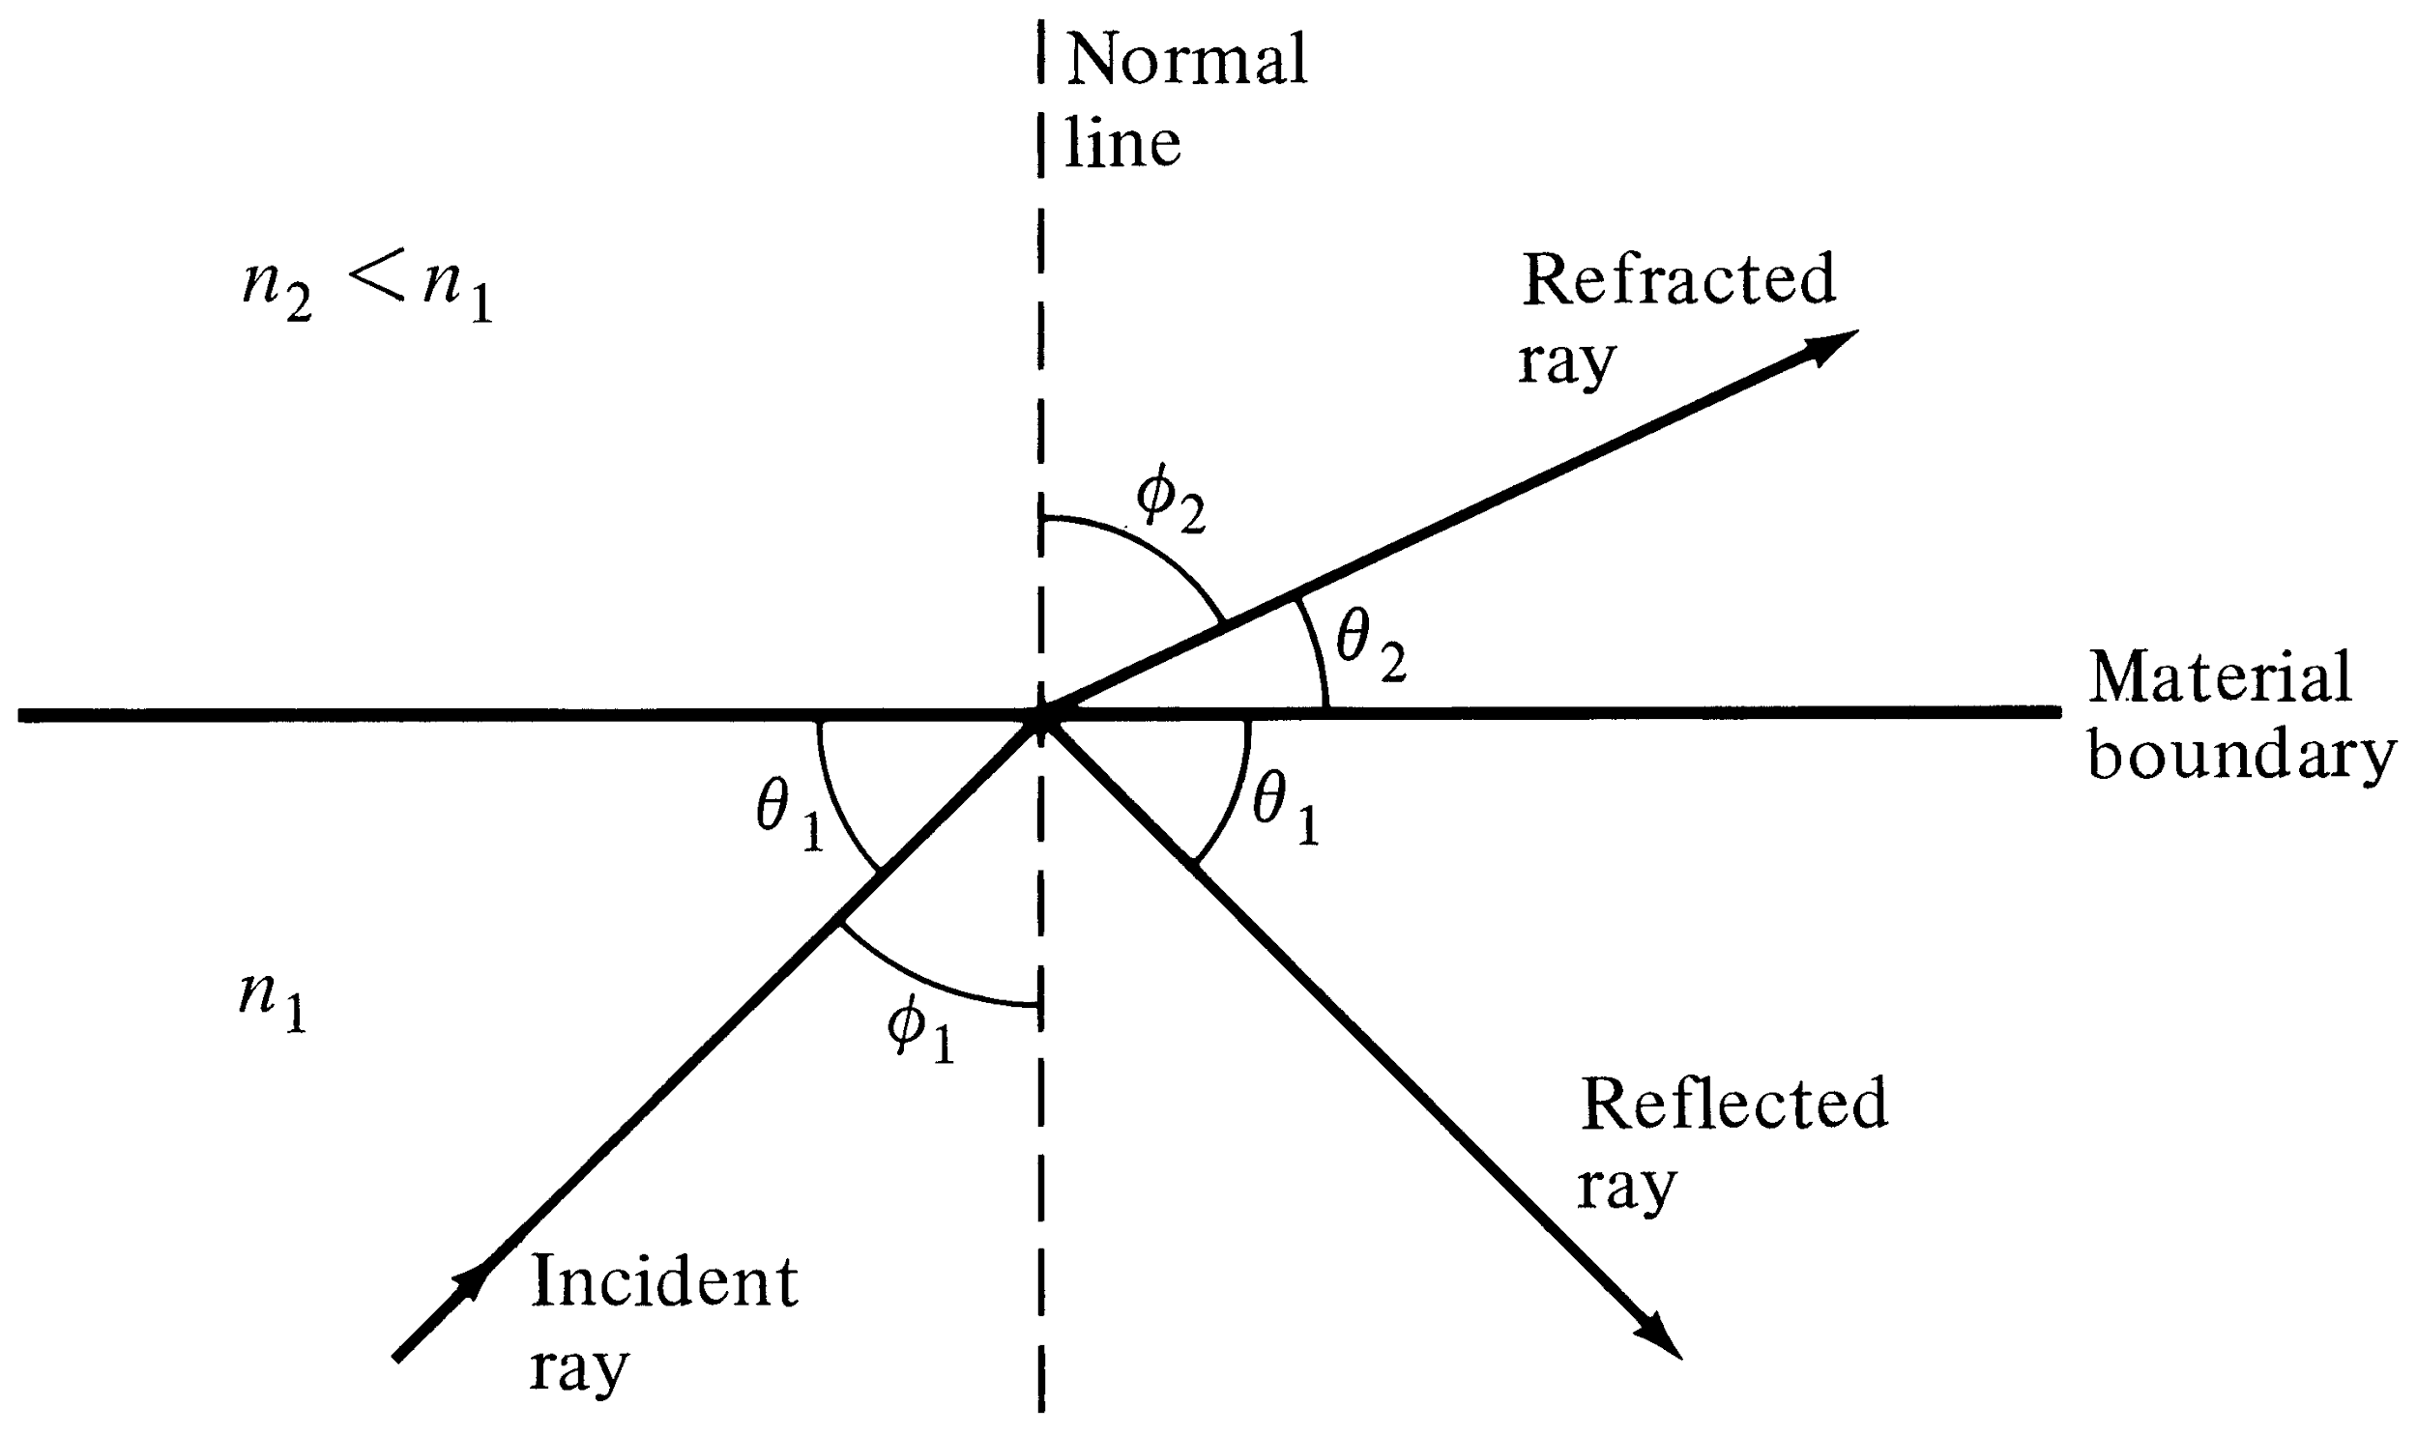
Refraction and Reflection of a light ray at a material boundary
Snell’s law: n₁ sin φ ₁ = n₂ sin φ ₂ (or) n₁ cos θ ₁ = n₂ cos θ₂

Slide 9
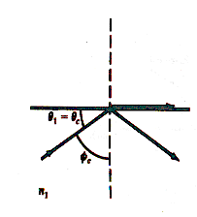
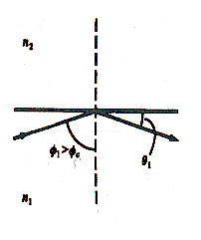
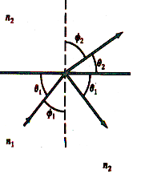
Representation of the Critical angle and total internal reflection at a glass-air interface
Sin φ _{c} = n ₂ / n ₁ (for φ ₂ = 90⁰ )

Slide 10
How do optical fibers work?
Optical fibers work on the principle of total internal reflection
Light waves (“modes”) are reflected and guided down the length of an optical fiber
CORE
CLADDING

Slide 11


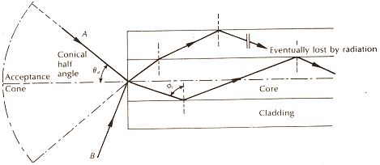
Launching Light into an Optical Fiber
ACCEPTANCE ANGLE (Θ_{C} ): is the maximum angle in which external light rays may strike the air/fiber interface and still propagate down the fiber with <10dB loss.
Numerical aperture:

Slide 12
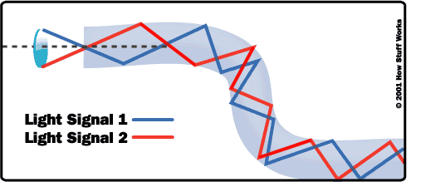
Total Internal Reflection in Fiber

Slide 13
Type of Fibers
Optical fibers come in two types:
Single-mode fibers – used to transmit one signal per fiber (used in telephone and cable TV). They have small cores(9 microns in diameter) and transmit infra-red light from laser.
Multi-mode fibers – used to transmit many signals per fiber (used in computer networks). They have larger cores(62.5 microns in diameter) and transmit infra-red light from LED.

Slide 14
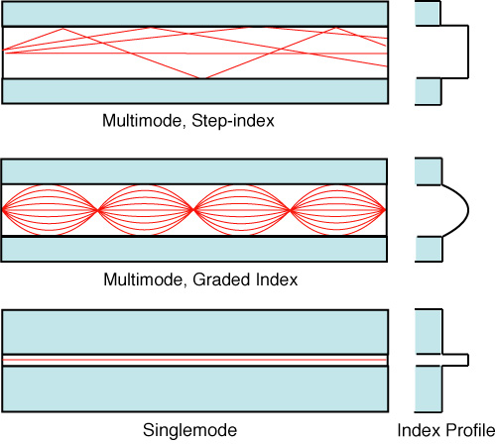
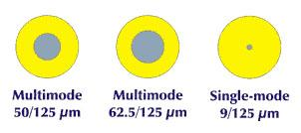
Light propagation through Fibers
Notes:
Optical fiber has two basic types, multimode and singlemode. Multimode fiber means that light can travel many different paths (called modes) through the core of the fiber, which enter and leave the fiber at various angles. The highest angle that light is accepted into the core of the fiber defines the numerical aperture (NA).Two types of multimode fiber exist, distinguished by the index profile of their cores and how light travels in them.
Step index multimode fiber has a core composed of one type of glass. Light traveling in the fiber travels in straight lines, reflecting off the core/cladding interface. The numerical aperture is determined by the differences in the indices of refraction of the core and cladding and can be calculated by Snell's law. Since each mode or angle of light travels a different path link, a pulse of light is dispersed while traveling through the fiber, limiting the bandwidth of step index fiber.
In graded index multimode fiber, the core is composed of many different layers of glass, chosen with indices of refraction to produce an index profile approximating a parabola. Since the light travels faster in lower index of refraction glass, the light will travel faster as it approaches the outside of the core. Likewise, the light traveling closest to the core center will travel the slowest. A properly constructed index profile will compensate for the different path lengths of each mode, increasing the bandwidth capacity of the fiber by as much as 100 times that of step index fiber.
Singlemode fiber just shrinks the core size to a dimension about 6 times the wavelength of the fiber, causing all the light to travel in only one mode. Thus modal dispersion disappears and the bandwidth of the fiber increases by at least another factor of 100 over graded index fiber.
FOTM, Chapter 2, DVVC, Chapter 11
Illustrate: VFL with SM and MM fiber

Slide 15
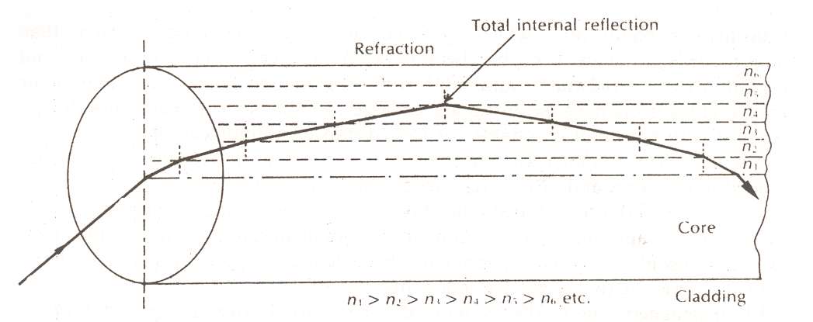
STEP-INDEX
A step-index fiber has a central core with a uniform refractive index. An outside cladding that also has a uniform refractive index surrounds the core;
however, the refractive index of the cladding is less than that of the central core.
GRADED-INDEX
In graded-index fiber, the index of refraction in the core decreases continuously between the axis and the cladding. This causes light rays to bend smoothly as they approach the cladding, rather than reflecting abruptly from the core-cladding boundary.

Slide 16
Single mode step-index fiber
ADVANTAGES
Minimum dispersion: all rays take same path same time to travel down the cable. A pulse can be reproduced at the receiver very accurately.
Less attenuation, can run over longer distance without repeaters.
Larger bandwidth and higher information rate.
DISADVANTAGES
difficult to couple light in and out of the tiny core
Highly directive light source (LASER) is required
Interfacing modules are more expensive

Slide 17
Multimode fibers
MULTIMODE STEP-INDEX FIBERS
In expensive; easy to couple light into fiber
Result in higher signal distortion; lower Tx rate
MULTIMODE GRADED INDEX FIBER
Intermediate between the other two types of fibers

Slide 18
Light propagation through Fibers
Notes:
Optical fiber has two basic types, multimode and singlemode. Multimode fiber means that light can travel many different paths (called modes) through the core of the fiber, which enter and leave the fiber at various angles. The highest angle that light is accepted into the core of the fiber defines the numerical aperture (NA).Two types of multimode fiber exist, distinguished by the index profile of their cores and how light travels in them.
Step index multimode fiber has a core composed of one type of glass. Light traveling in the fiber travels in straight lines, reflecting off the core/cladding interface. The numerical aperture is determined by the differences in the indices of refraction of the core and cladding and can be calculated by Snell's law. Since each mode or angle of light travels a different path link, a pulse of light is dispersed while traveling through the fiber, limiting the bandwidth of step index fiber.
In graded index multimode fiber, the core is composed of many different layers of glass, chosen with indices of refraction to produce an index profile approximating a parabola. Since the light travels faster in lower index of refraction glass, the light will travel faster as it approaches the outside of the core. Likewise, the light traveling closest to the core center will travel the slowest. A properly constructed index profile will compensate for the different path lengths of each mode, increasing the bandwidth capacity of the fiber by as much as 100 times that of step index fiber.
Singlemode fiber just shrinks the core size to a dimension about 6 times the wavelength of the fiber, causing all the light to travel in only one mode. Thus modal dispersion disappears and the bandwidth of the fiber increases by at least another factor of 100 over graded index fiber.
FOTM, Chapter 2, DVVC, Chapter 11
Illustrate: VFL with SM and MM fiber

Slide 19
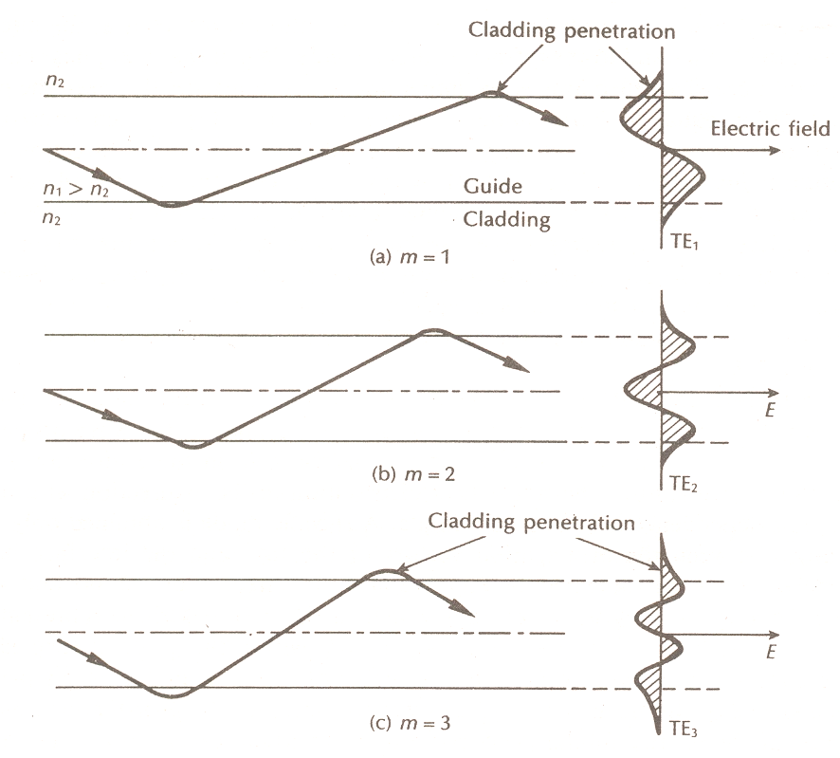
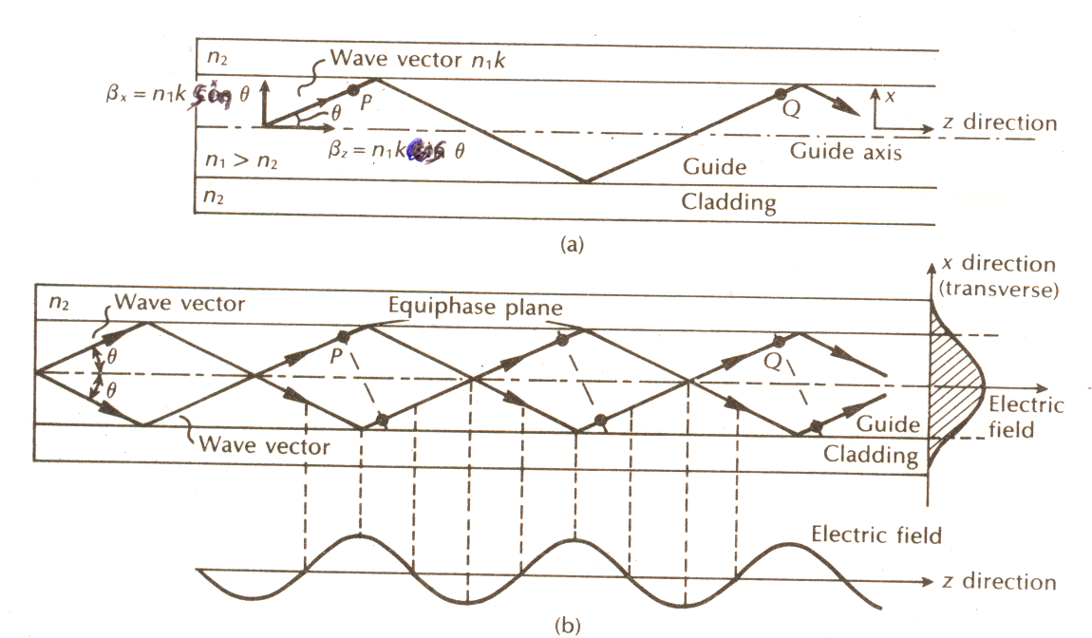
Modes in Optical Fibers
Mode is a stable propagation state in an optical fiber
If light travels along certain paths, the EM fields reinforce each other to form a field distribution that is stable as it travels down the fiber.
If the light tries to travel other paths, a stable wave will not propagate – thus no mode

Slide 20
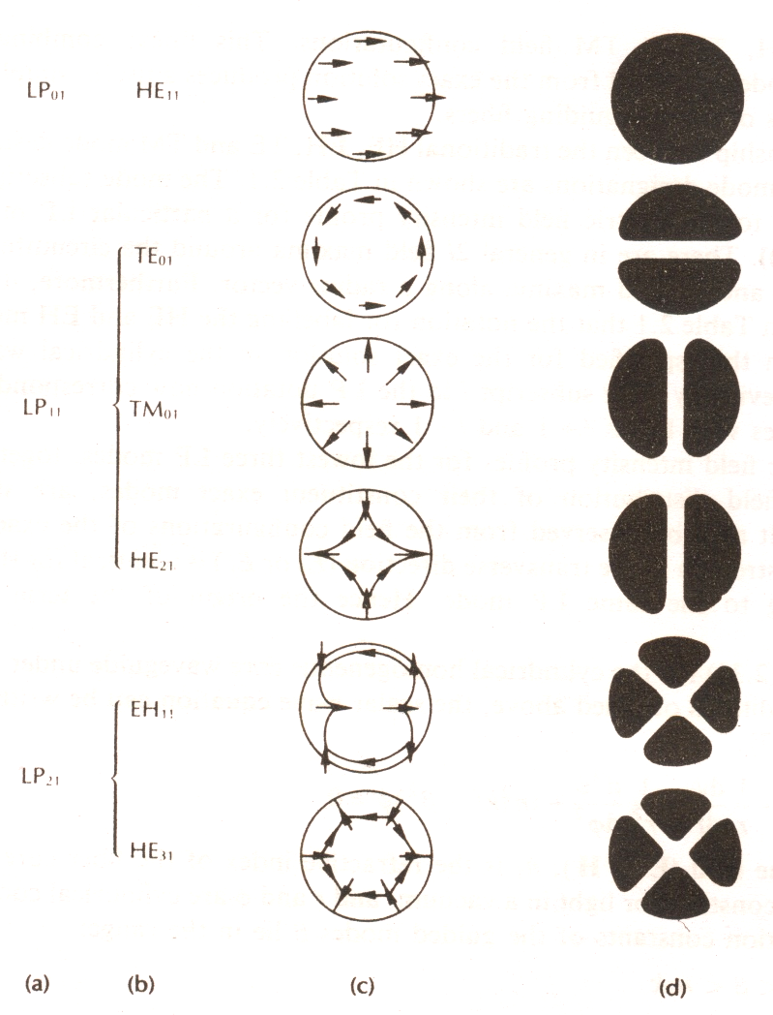
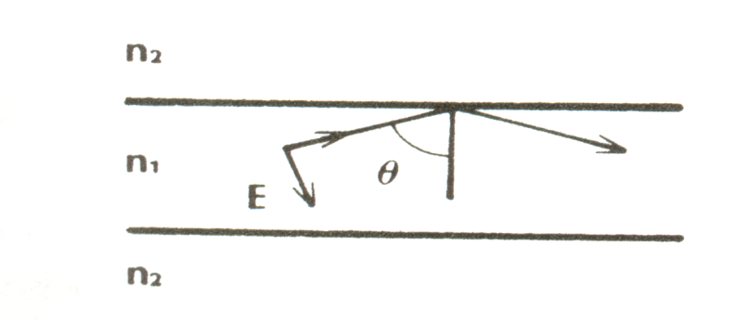
Electric Field Configurations in Cylindrical Fiber
Model Equation
(Jν+Kν) (k₁² Jν+ k₂² Kν)
= (βν/a)² (1/u² ⁺ 1/w²)²
Condition for Bound Mode
n₂ k = k₂ ≤ β ≤ k₁ = n₁k
TM mode for H_{z} = 0 and E_{z} ≠ 0
TE mode for E_{z} = 0 and H_{z} ≠ 0

Slide 21
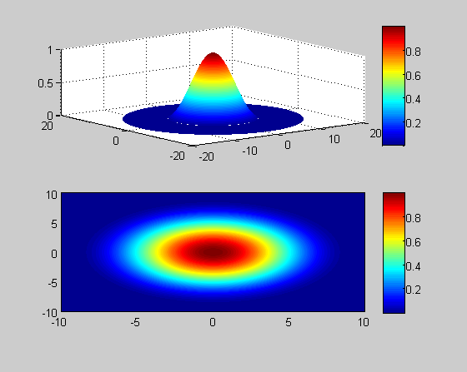
Modes in single mode fiber
LP01

Slide 22
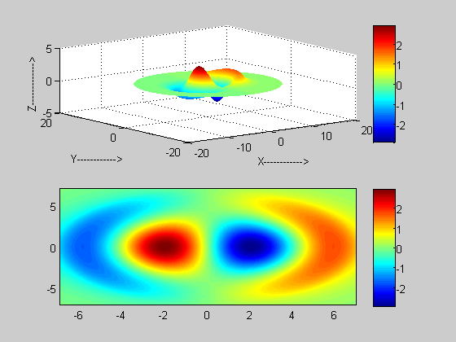
Modes in multimode fiber
LP01
LP11

Slide 23
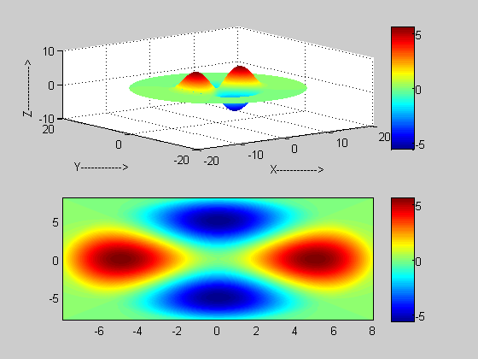
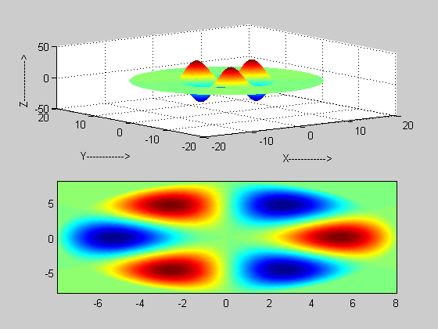
LP21
LP31

Slide 24
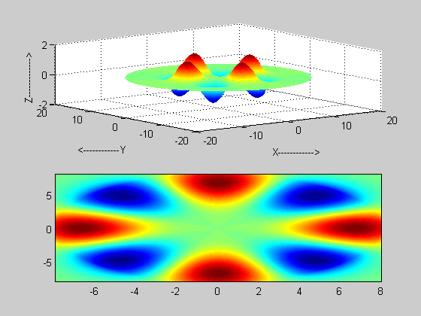
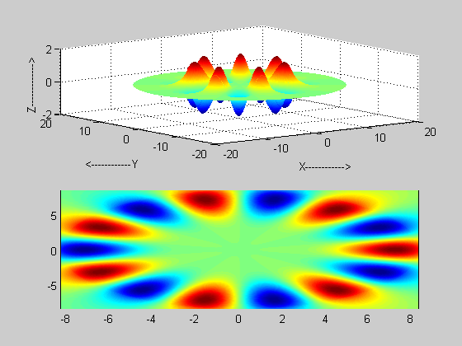
LP41
LP71

Slide 25
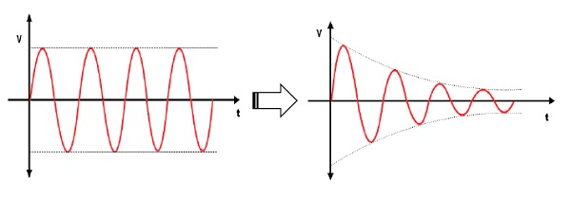
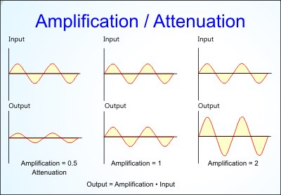
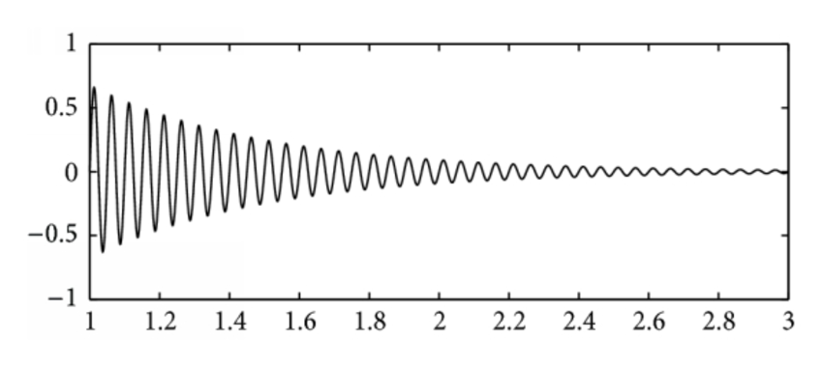
Specifications of Optical Fiber
Attenuation
Loss of signal, measured in dB

Slide 26
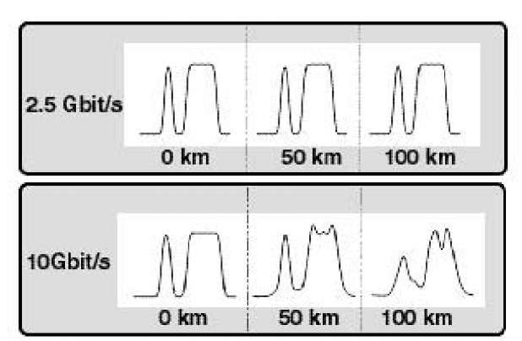
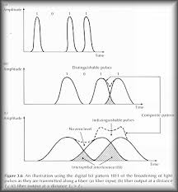
Specifications of Optical Fiber
Dispersion
Blurring of a signal, affects bandwidth

Slide 27
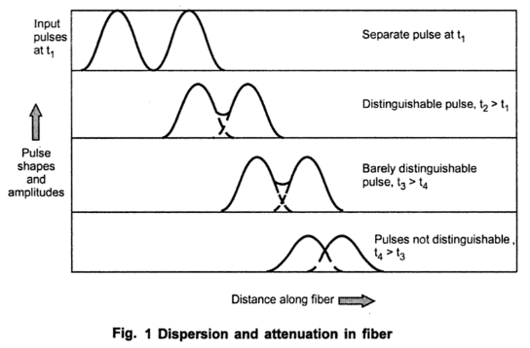
Specifications of Optical Fiber
Dispersion and attenuation

Slide 28
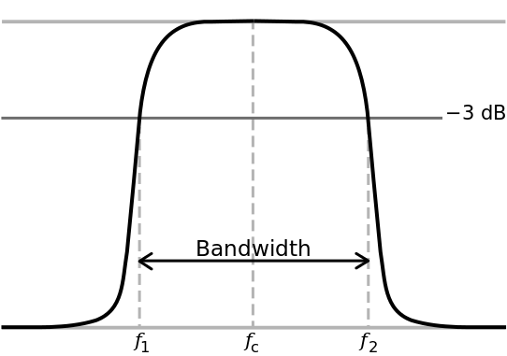
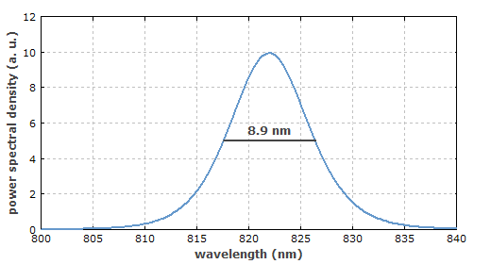
Specifications of Optical Fiber
Bandwidth
The number of bits per second that can be sent through a data link

Slide 29
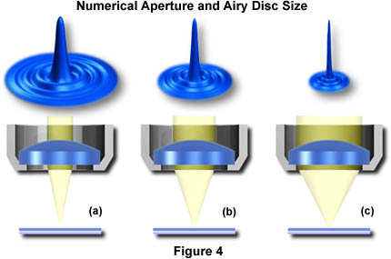
Specifications of Optical Fiber
Numerical Aperture
Measures the largest angle of light that can be accepted into the core

Slide 30
The predominant losses in optic fibers are
Absorption losses due to impurities in the fiber material
Material (or) Rayleigh scattering losses due to microscopic irregularities in the fiber
Chromatic (or) wavelength dispersion because of the use of a non-mono chromatic source
Radiation losses caused by bends and kinks in the fiber
Modal dispersion (or) pulse spreading due to rays taking different paths down the fiber.
Coupling losses caused by misalignment & imperfect surface finishes

Slide 31
Attenuation
Light travelling through an optical fiber exhibits a power that decreases exponentially with the distance as a result of absorption and scattering.
Attenuation limits the magnitude of the optical power transmitted
Loss Mechanisms
Absorption by atomic defects
(missing molecules, high density clusters of atom groups or oxygen defects in the glass structure)
Scattering
(microscopic variations in the material density, compositional fluctuations, structural in homogeneities or defects during fiber manufacturing)
Macrobending
Microbending

Slide 32
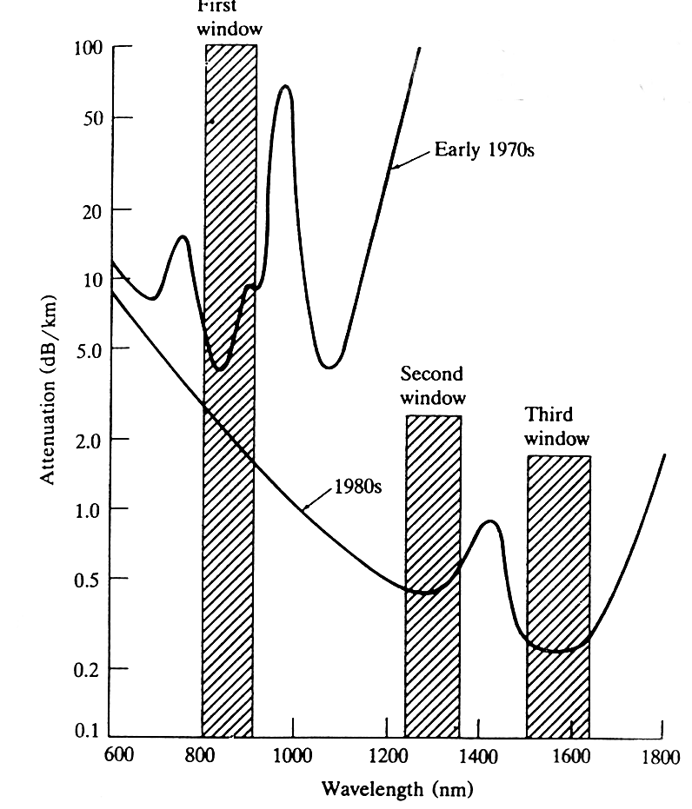
Optical fibers - attenuation
Traditionally two windows available:
1.3 μm and 1.55 μm
The lower window is used with Si and GaAlAs and the upper window with InGaAsP compounds
Nowadays these attenuation windows no longer separate (water-spike attenuation region can be removed)
There are single- and monomode fibers that may have step or graded refraction index profile
Propagation in optical fibers is influenced by attenuation, scattering, absorption, and dispersion
In addition there are non-linear effects that are important in WDM-transmission
Water
spike
2000s

Slide 33
Transmission windows
Band | Description | Wavelength Range
O band | original | 1260 to 1360 nm
E band | extended | 1360 to 1460 nm
S band | short wavelengths | 1460 to 1530 nm
C band | conventional ("erbium window") | 1530 to 1565 nm
L band | long wavelengths | 1565 to 1625 nm
U band | Ultra-long wavelengths | 1625 to 1675 nm

Slide 34
Absorption & Scattering
Three Types
Intrinsic - UV Electronic Transitions
- IR Molecular Vibrations
Impurity - Transition Metals
- OH Vibration Overtones
- H₂ Vibration Overtones
Defects - Draw Induced & Radiation Induced
Two types
Rayleigh – Minute density fluctuations intrinsic to the
material
- Proportional to λ⁻⁴
Imperfections - Bubbles, inclusions, cracks, etc.
- λ Independent

Slide 35
Dispersion
When a short pulse of light travels through an optical fiber its power is “dispersed” in time so that the pulse spreads into a wider time interval. There are four sources of dispersion in optical fibers:
Modal dispersion . 2 .Material dispersion
3. Waveguide dispersion 4 .Nonlinear dispersion
Modal dispersion: modal dispersion occurs in multimode fibers as a result of the differences in the group velocities of the modes.
Waveguide dispersion: the group velocities of the modes depends on the wavelength even if material dispersion is negligible. This dependence , known as waveguide dispersion.

Slide 36
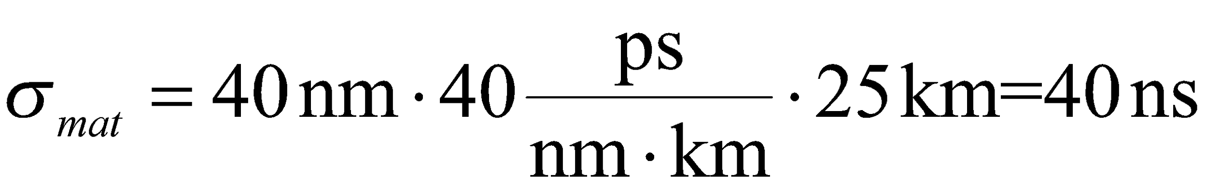
Chromatic dispersion
Chromatic dispersion (or material dispersion) is produced when different frequencies of light propagate in fiber with different velocities
Therefore chromatic dispersion is larger the wider source bandwidth is. Thus it is largest for LEDs (Light Emitting Diode) and smallest for LASERs (Light Amplification by Stimulated Emission of Radiation) diodes
LED BW is about 5% of λ₀ , Laser BW about 0.1 % or below of λ₀
Optical fibers have dispersion minimum at 1.3 μm but their attenuation minimum is at 1.55 μm. This gave motivation to develop dispersion shifted fibers .
Example: GaAlAs LED is used at λ₀=1 μm. This source has spectral width of 40 nm and its material dispersion is D_{mat}(1 μm)=40 ps/(nm x km). How much is its pulse spreading in 25 km distance?

Slide 37
Why Silica-Based Glass ?
Intrinsic low loss in NIR where Sources and detectors are available.
Minimum in material dispersion Coincides with low loss wavelengths.
Intrinsic high strength.
Excellent chemical durability and stability.
Low thermal expansion.
High purity Chemicals available.
Low cost and toxicity.

Slide 38
Light sources
LED (Light Emitting Diodes)
Made from material such as AlGaAs (or) AlGaP
Light is emitted when electrons and holes recombines
Either surface emitting (or) edge emitting
Injection Laser Diodes (ILD)
Similar in construction as LED except ends are highly polished to reflect photons back and fourth

Slide 39
Light Detectors
PIN diodes
Photons are absorbed in the intrinsic layers
Sufficient energy is added to generate carriers in the depletion layer for current to flow through the device
AVALANCHE PHOTO DIODES (ADP)
Photo generated electrons are accelerated by relatively larger reverse voltage and collide with other atoms to produce more free electrons
Avalanche multiplication effect makes APD more sensitive but also more noisy than PIN diodes

Slide 40

Fiber Optic Sign

Slide 41
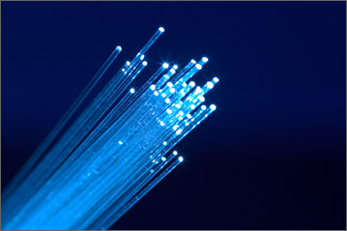
Thank you

